Slide 1
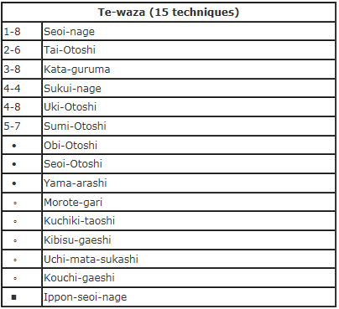
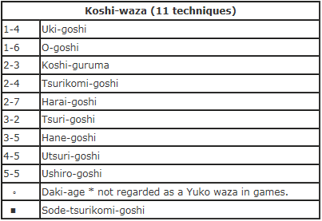
Videos: http://www.belmontjudo.com/throws_67.htm

Slide 2
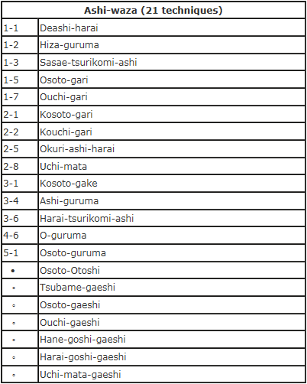
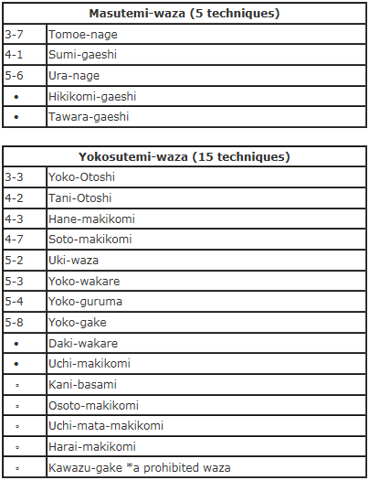

Slide 3
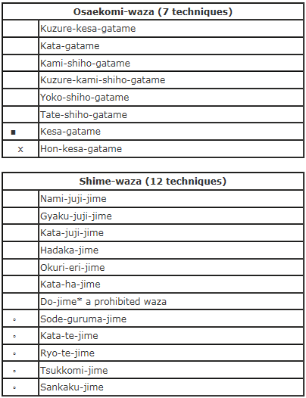
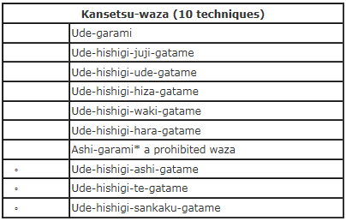
Videos: Osaekomi-wasa http://www.belmontjudo.com/holddowns_7.htm
Shime-wasa http://www.belmontjudo.com/chokes_12.htm
Kansetsu-wasa http://www.belmontjudo.com/jointlocks_10.htm

